Slide 1





PAVEMENT INDUSTRY
TERRA PAVE PRODUCTS
for
PAVEMENT INDUSTRY
TERRA PAVE PRODUCTS are the ECO-FRIENDLY COST-EFFECTIVE SOLUTIONS to the CHALLENGES in these MARKETS
TERRA PAVE TEAM

Slide 2
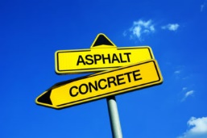
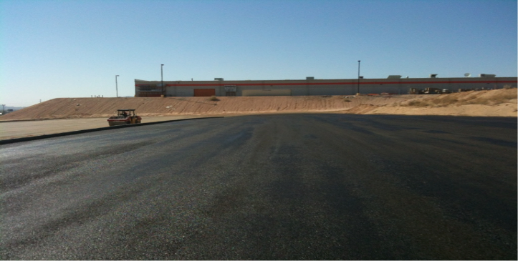
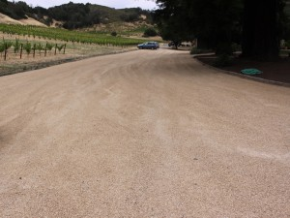






INTRODUCING
TERRA PAVE PRODUCTS
IMPROVING the ROADS of the WORLD™

Slide 3

Innovation
Terra Pave International of The University of Texas at Austin (UTA-TPI), has developed COST-EFFECTIVE, ECO-FRIENDLY, water-based polymer products for CONSTRUCTING and MAINTAINING roadways, parking lots, airfields, and all other traffic-bearing surfaces.
EEI is the leader in SUSTAINABILITY and REVOLUTIONIZING the field of pavement materials, zero-energy custom building, solar electric yachts, and solar renewable energy.

Slide 4

EEI/UT-TPI’s PRODUCTS – Terra Pave
EEI/UTA-TPI’s line of Eco-Friendly, Non-Toxic, Non-Petroleum-based, Non-Corrosive, Non-Hazardous, Waterproof, Water-based polymer products address most aspects of pavement construction and maintenance:
  Early maintenance/Pavement preservation
  New construction
  Unpaved dirt roads
https://youtu.be/4449TZvtCdU

Slide 5
EEI/UT-TPI’s PRODUCTS – TERRA PAVE
ROAD MAINTENANCE:
Early asphalt maintenance/Pavement preservation
  Fog Seal – Terra Fog
  Albedo Cool Pavement Seal – Terra Pave Albedo Cool Pavement
NEW ROAD CONSTRUCTION:
New construction – Waterproof layer MC30 replacement
  Prime Coat – Terra Prime
Unpaved dirt roads, airfields, parking lots, road base, etc..
  Concrete Replacement – Top-Seal White
Paved roads, highways, runways, etc..
  Concrete Replacement – Top-Seal White
  Wearing Surface/Asphalt Replacement – Top-Seal Black

Slide 6
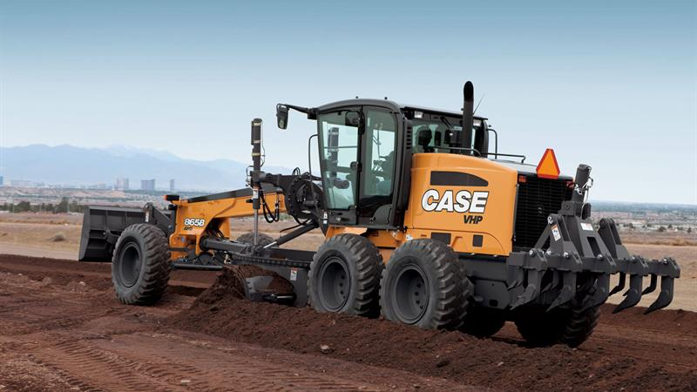
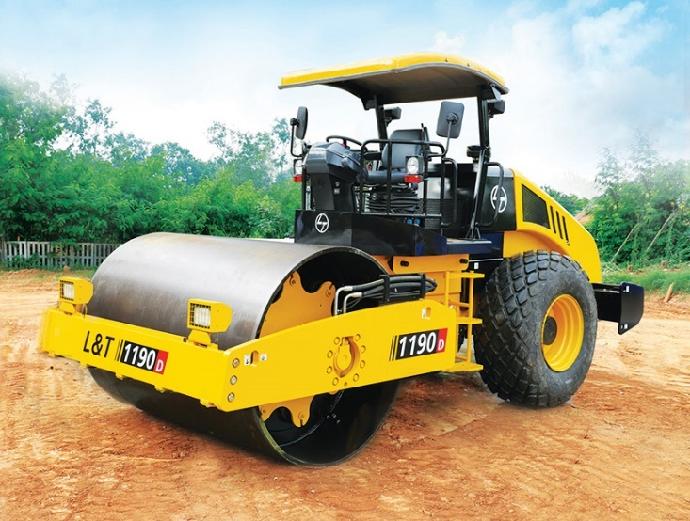
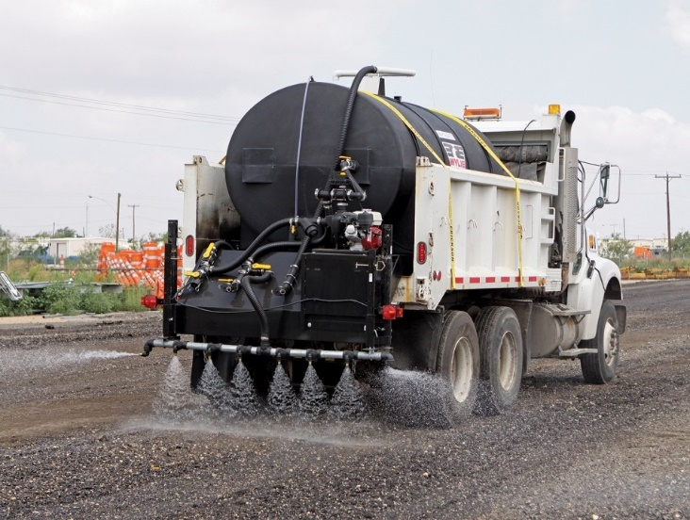


Terra Pave PRODUCTS –
Materials & Equipment Cost Saving
* Soil Grader * Soil Compactor * Water Sprayer
NO SPECIAL EQUIPMENT or HANDLING PROCEDURES REQUIRED
TERRA PAVE ENVIRONMENTALLY SAFE
NON-HAZARDOUS
NON-CORROSIVE
NON-PETROLEUM BASED
NON-TOXIC
WATERPROOF
IMPROVED BRAKING DISTANCE
COST-EFFECTIVE

Slide 7
Main applications – Terra Pave Products
Terra Pave PRODUCTS – APPLICATIONS
Cost-Effective
Non-Hazardous
Non-Corrosive
Non-Petroleum Based
Non-Toxic
Waterproof
Improved Braking Distance
Environmental Eco-Friendly with No Special Handling
Asphalt Pavement Roads replacement/repair Aircraft Runways Base Stabilization
Bifacial Solar Panel Albedo Surface BMX Tracks Bunker Liners
Cart Paths Cars/Vehicles Lots Driveways/Dirt Roads
Farms & Ranches Foundations Golf Courses
Hazardous Material Capping & Sealing Heavy Haul Roads & Mining Roads Helicopter Landing Pads
Horse Farms & Arenas Hydroseed & Hydromulch Tackifier Landfill Capping & Reclamation
Military Convoy & Tank Trails Mine Tailings Capping & Reclamation Odor & Vapor Suppression
Parking Lots / Roads Shoulders Slope Erosion Control
Solar Farm Roads / Access Roads Temporary Roads & Detours Walking Trails & Paths
Water Retention Basins Pond Linings … and MUCH MORE

Slide 8
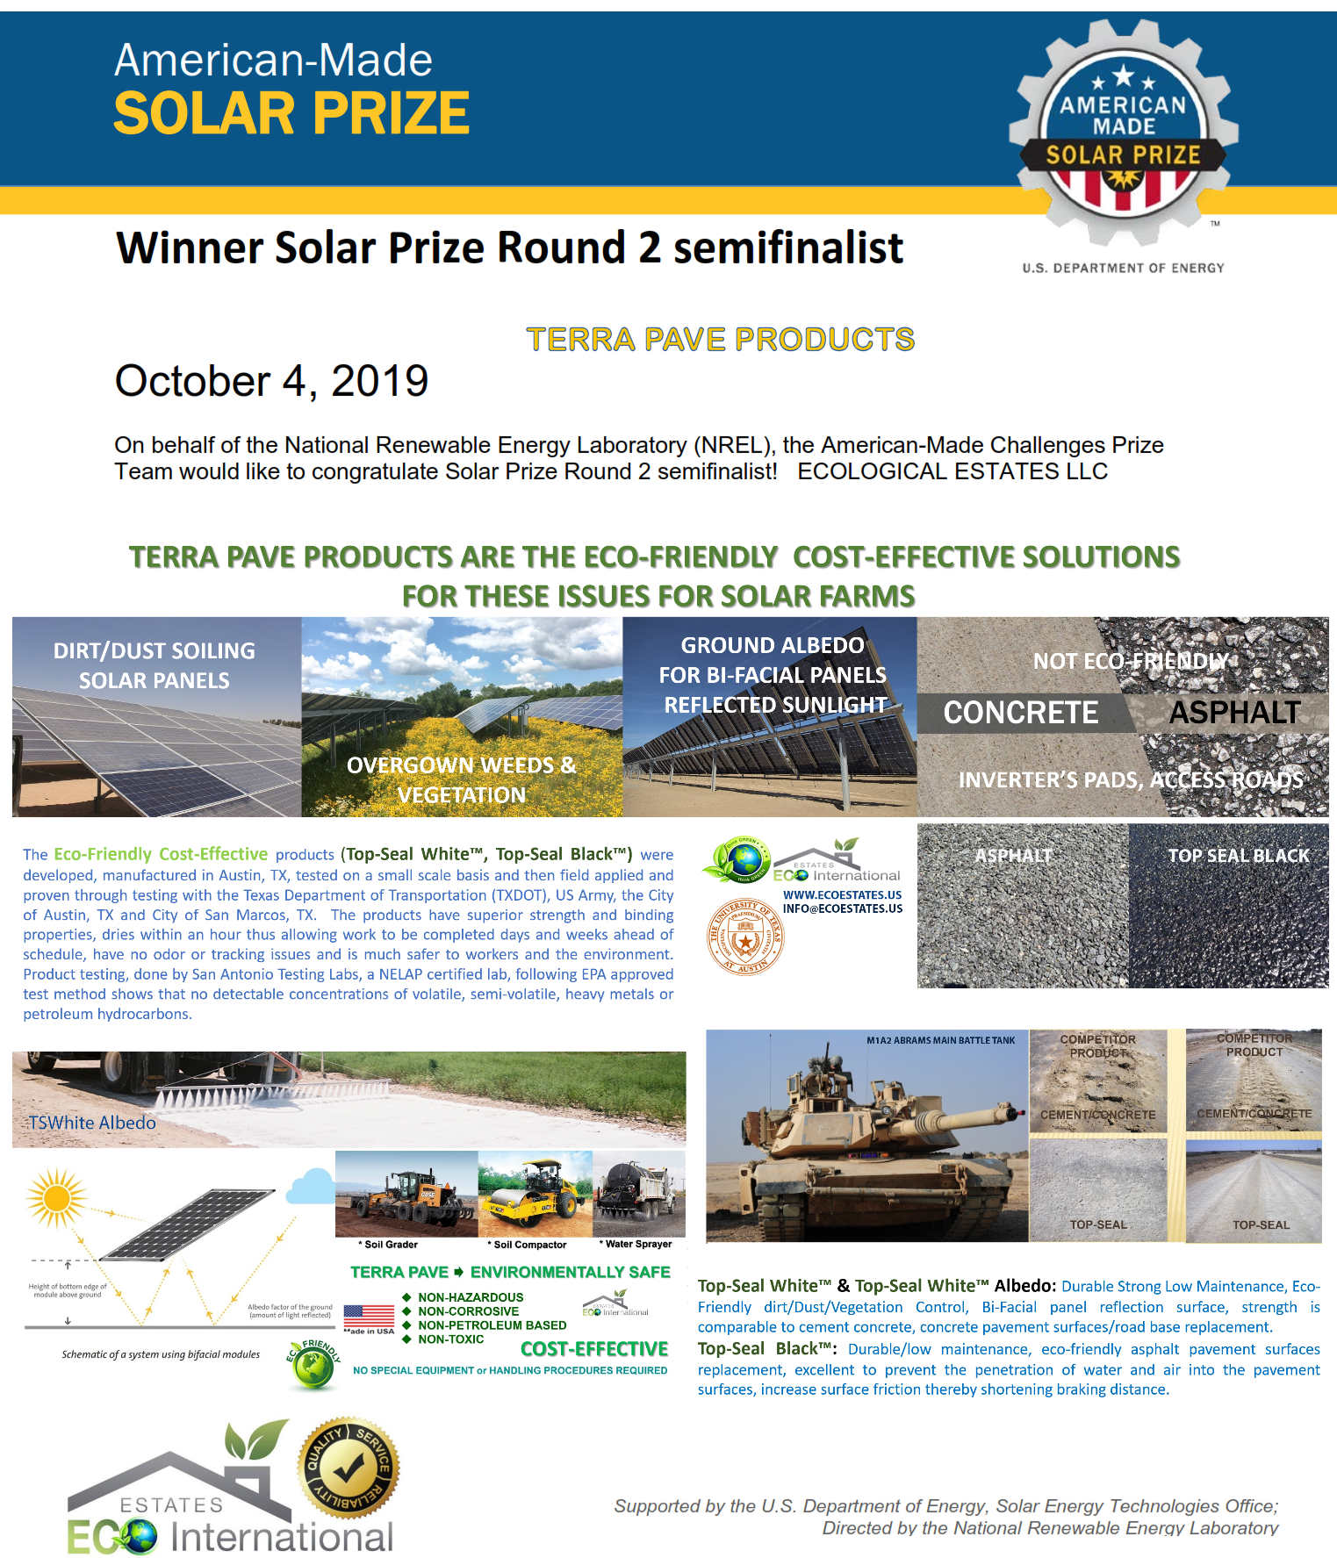




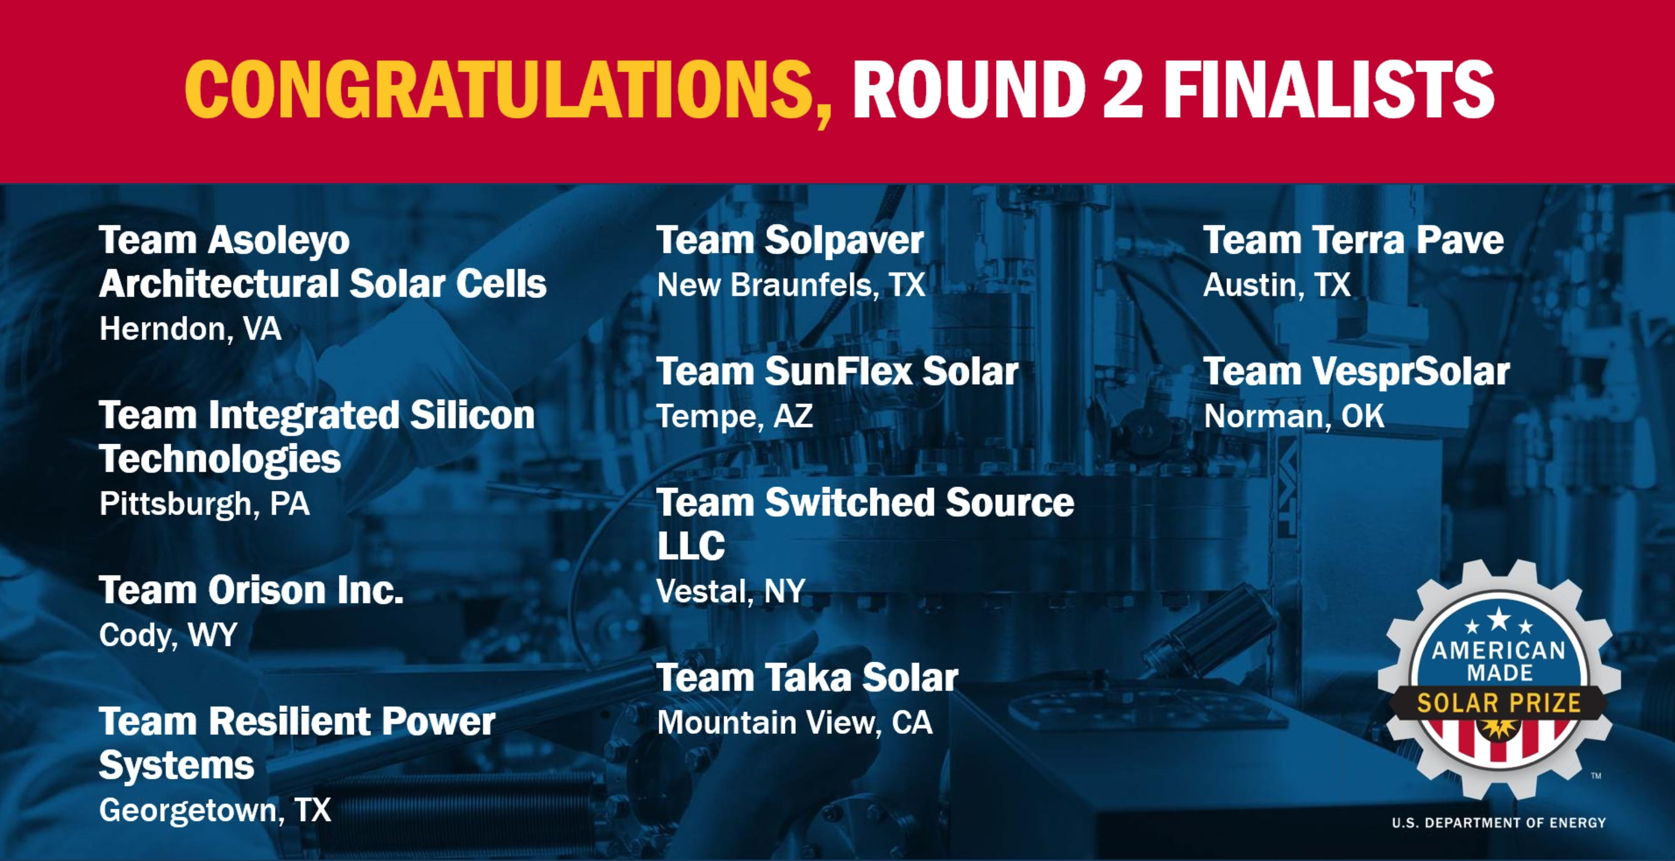
NREL USA Department of Energy –
AWARD top 10 2019-2020
TOP 10 Eco-Friendly Products 2019-2020
National Renewable Energy Lab
USA Department of Energy

Slide 9

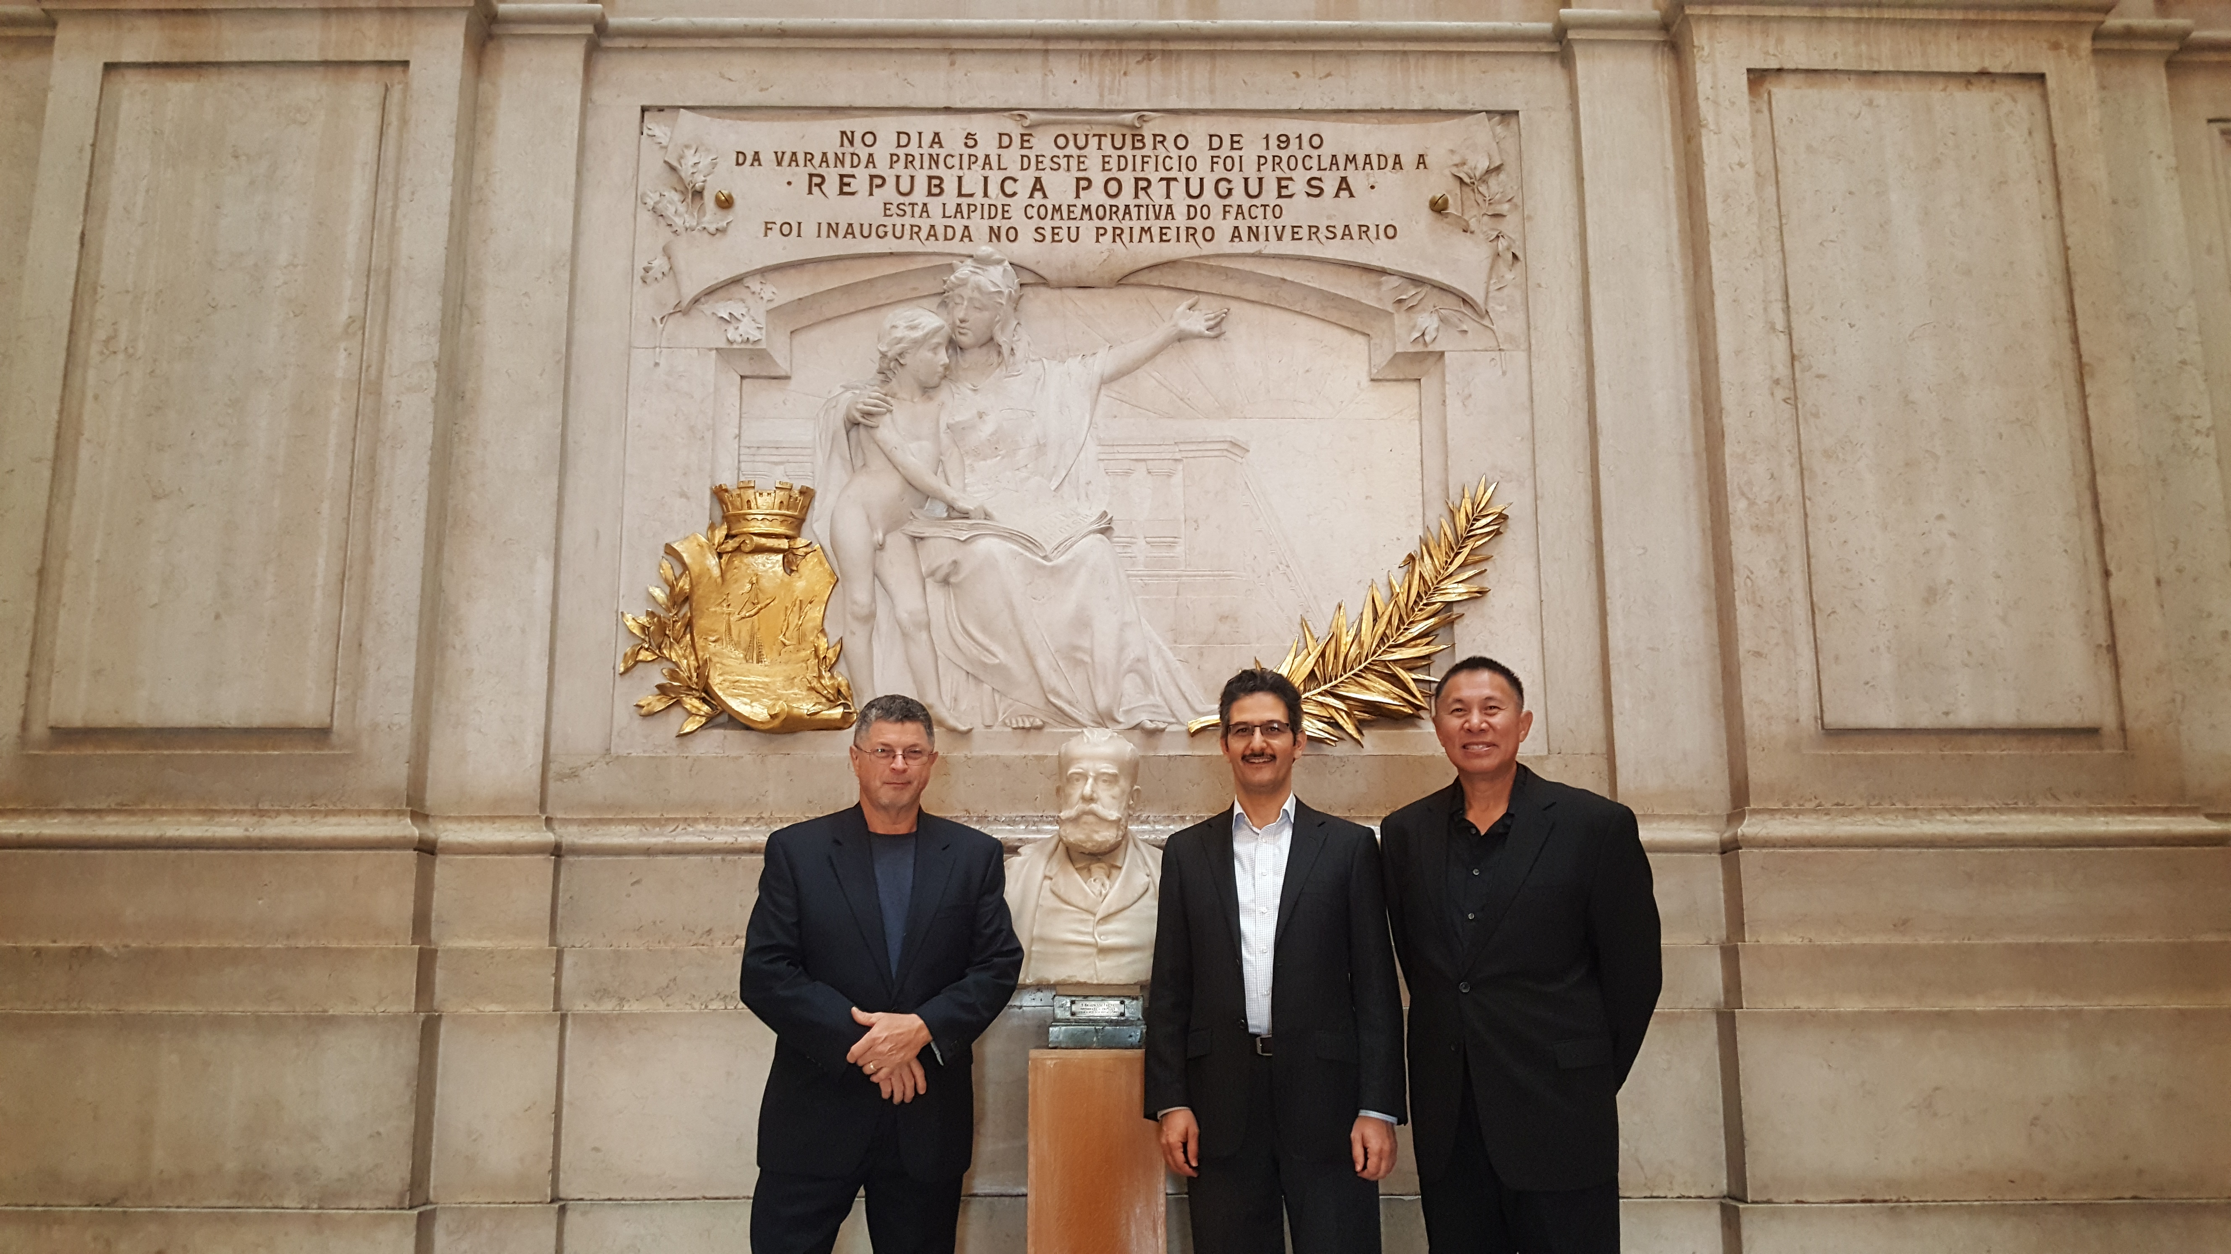
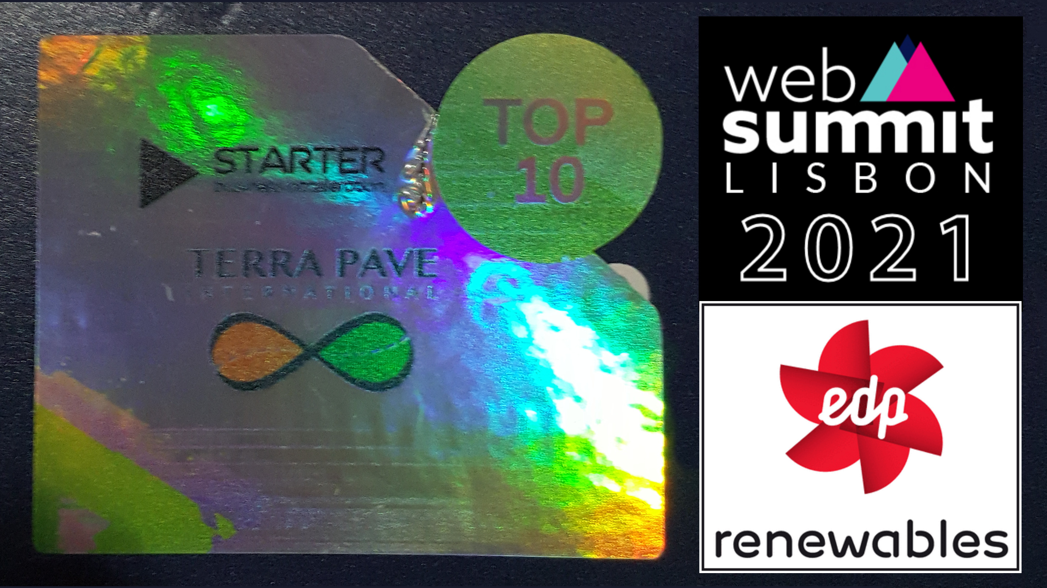

WEBSUMMIT LISBON, PORTUGAL
November 2021 – TOP 10 WORLD WINNER
TOP 10 Eco-Friendly Products in the WORLD 2021
Web Summit Lisbon, Portugal

Slide 10


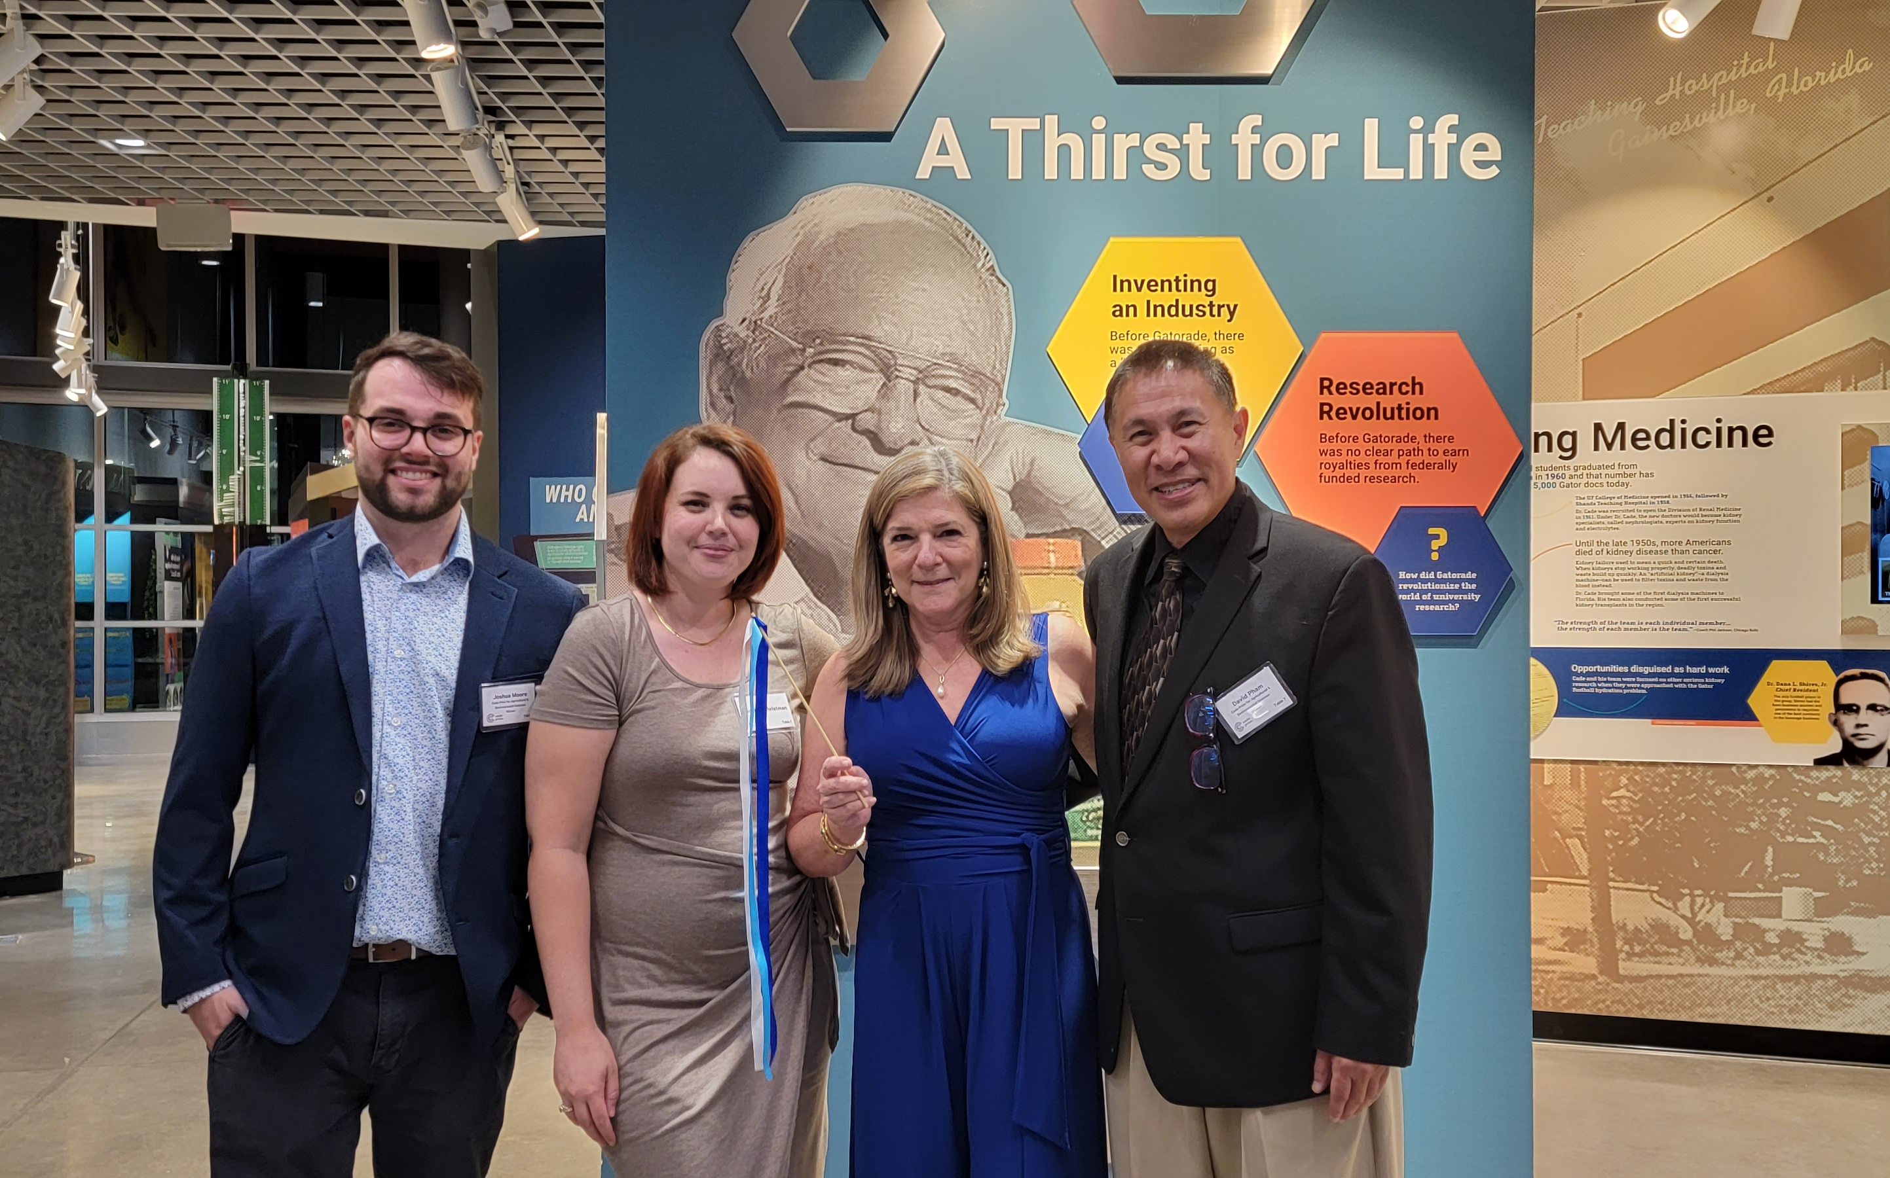
CADY PRIZE Ag. & Environmental
SEPt 28, 2023 – TOP #1 WINNER
TOP #1 Eco-Friendly Products in the USA 2023
CADY Prize for Ag and Environmental Category

Slide 11
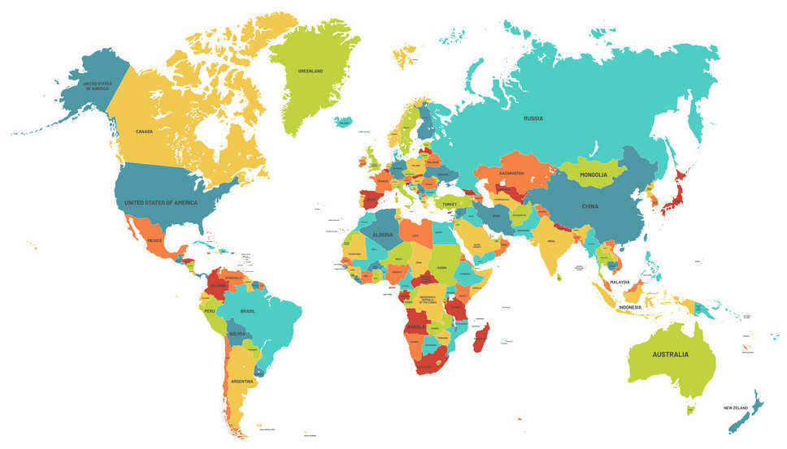


Promoted & sold in +30 countries
Terra Pave Products were
tested by
USA
Mexico
Belize
Chile
Brazil
Columbia
Peru
Vietnam*
Malaysia*
Indonesia*
Philippines*
Burma*
India*
South Africa
Morroco
UAE
Saudi Arabia
Kenya
Ivory Coast
Namibia
And many others

Slide 12
TOP-SEAL
TOP-SEAL
TM
TP FOG & TP ALBEDO COOL PAVEMENTS
Asphalt / Concrete Roads Maintenance Products
Pavement Preservation
Chip Seal Preservation

Slide 13


TOP-SEAL
TOP-SEAL
TM
TOP-SEAL TERRA FOG (black color)
Asphalt Maintenance Product
Pavement Preservation
Chip Seal Preservation
APPROVED BY TXDoT
(Texas Department of Transportation)

Slide 14
Definition of Pavement Preservation
The USA Federal Highway Administration (FHWA) defines pavement preservation:
A program employing a network-level, long-term strategy that enhances pavement performance by using an integrated, cost-effective set of practices that:
  extend pavement life,
  improve safety, and
  meet motorist expectations (enjoyable ride)
  no car damages due to distressed roads.

Slide 15
Definition of Pavement Preservation
The chart below illustrates the performance of pavements over time.

Slide 16

Definition of Pavement Preservation

Slide 17
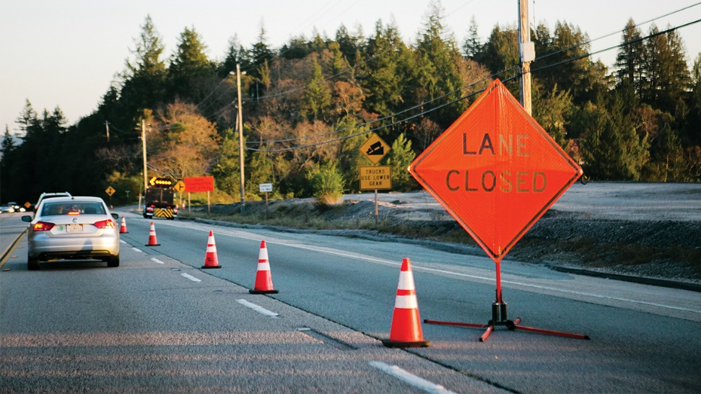
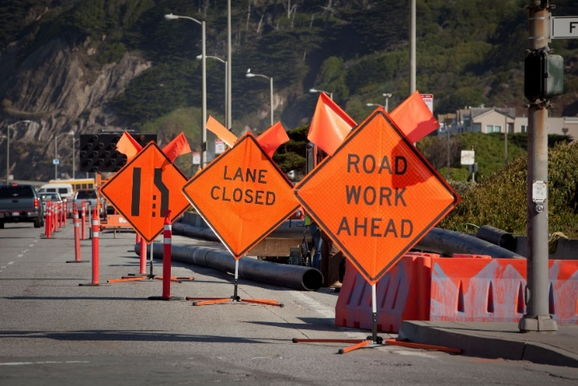
Pavement Preservation
Pavement preservation utilizes a combination of preventive and routine maintenance, with a heavy emphasis on prevention.
Maintaining roads in good condition is:
or Preventive Maintenance:
  easier,
  faster,
  minimize traffic disruptions,
  less costly than repairing roads with heavy damage.

Slide 18

Pavement Preservation
Much less costly 4x-5x

Slide 19
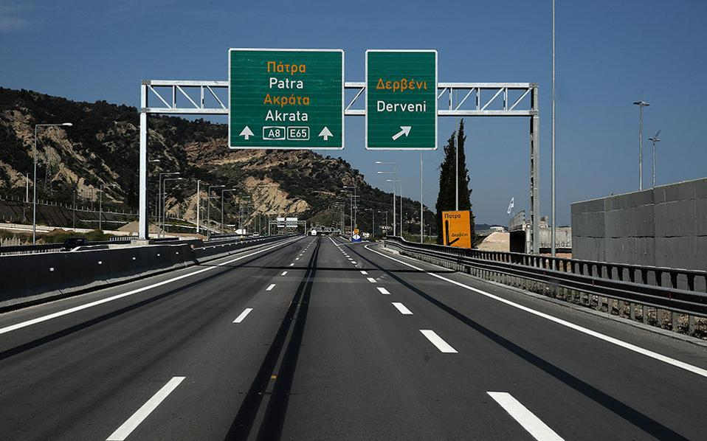
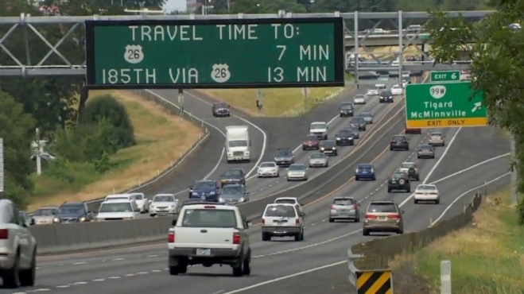
Pavement Preservation
This maintenance strategy offers many benefits to road users as well.
  By keeping roads in good condition, preventive maintenance improves safety conditions.
  Enjoyable ride & no car damages due to distressed roads.
  The ride quality of the road is increased, making driving a more comfortable and pleasant experience

Slide 20
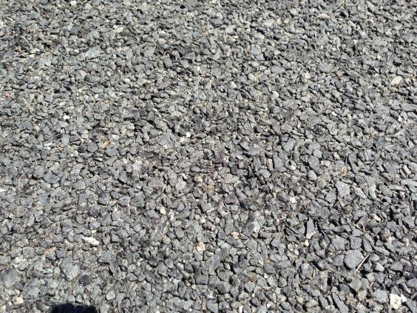
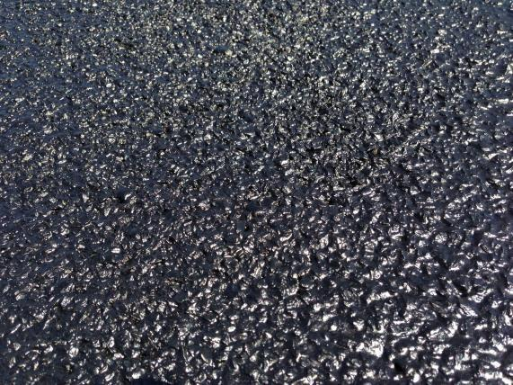
TERRA FOG
Before Application with Terra Fog ™
After Application with Terra Fog ™
Terra Fog is a high-quality, environment-friendly, and cost-effective solution for improving performance and extending service life in chip seals, and asphalt pavements.

Slide 21
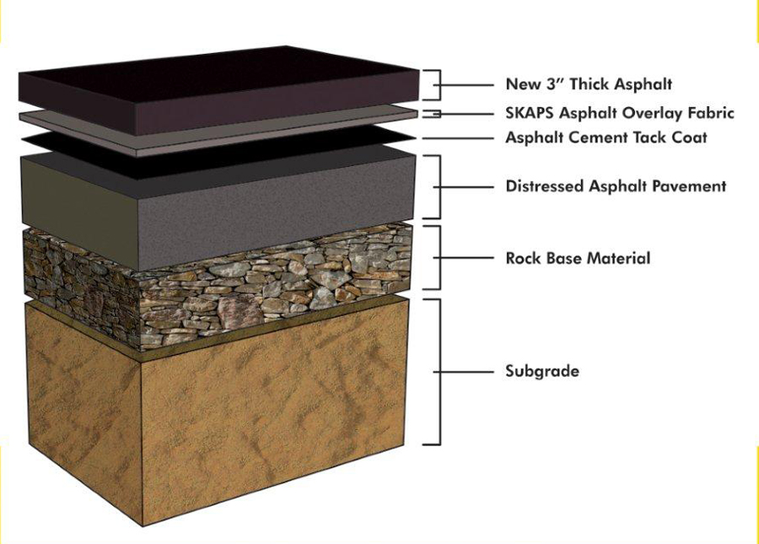

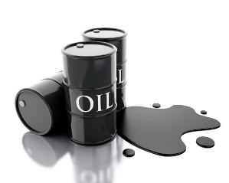

Pavement Preservation
TOXIC Process to Repair Distressed Asphalt Pavement
TERRA FOG
Existing Distressed
Asphalt Road stack
EXPENSIVE,
TIME CONSUMING,
TOXIC HAZADOUS
CLIMATE WRECKING
Eco-Friendly, Cost-Effective
Preventive Maintenance
PROCESS

Slide 22
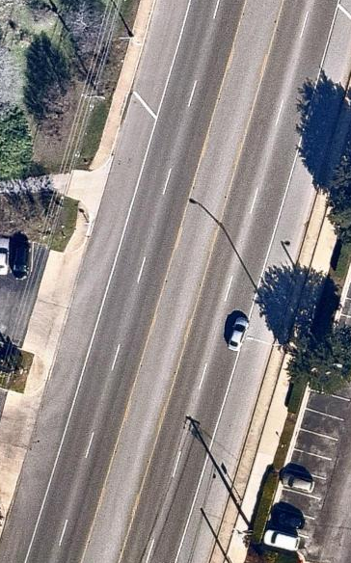
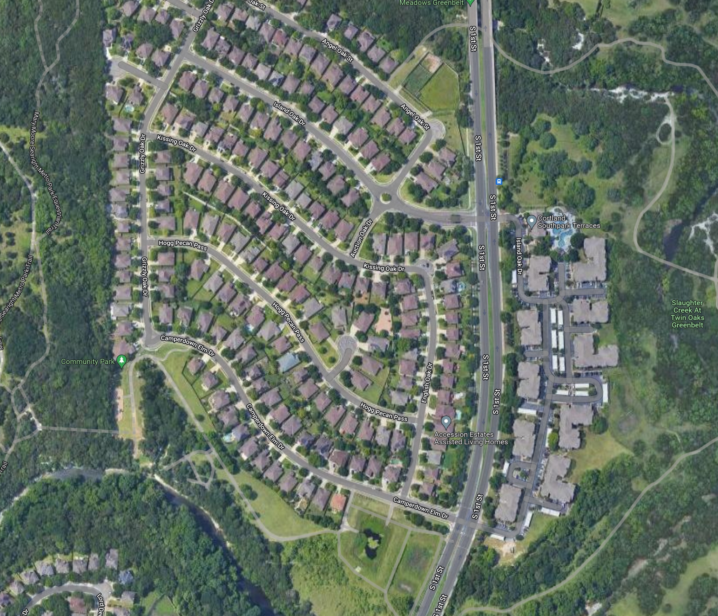


Terra Fog City of Austin 1st street Test Section
https://youtu.be/BjJ19b6il3M

Slide 23
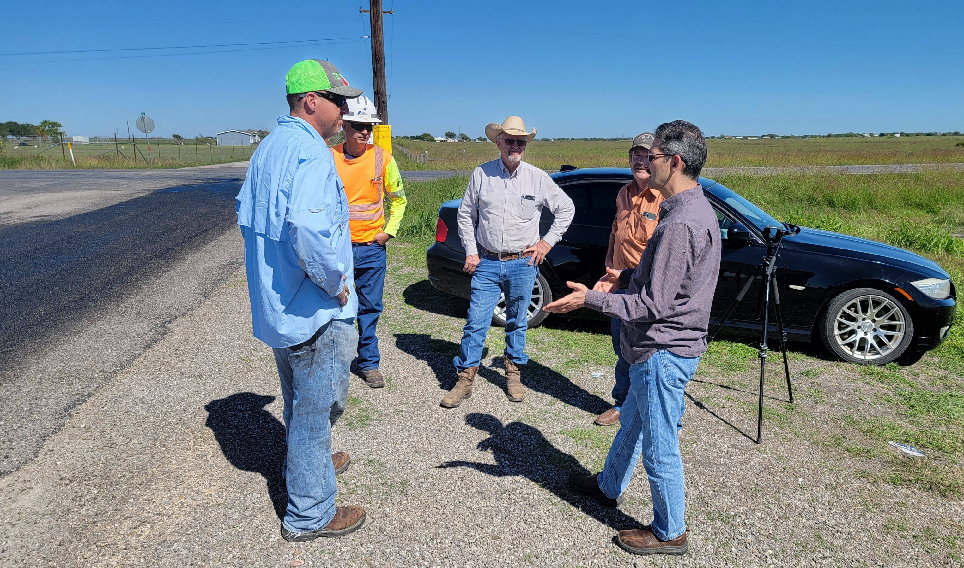
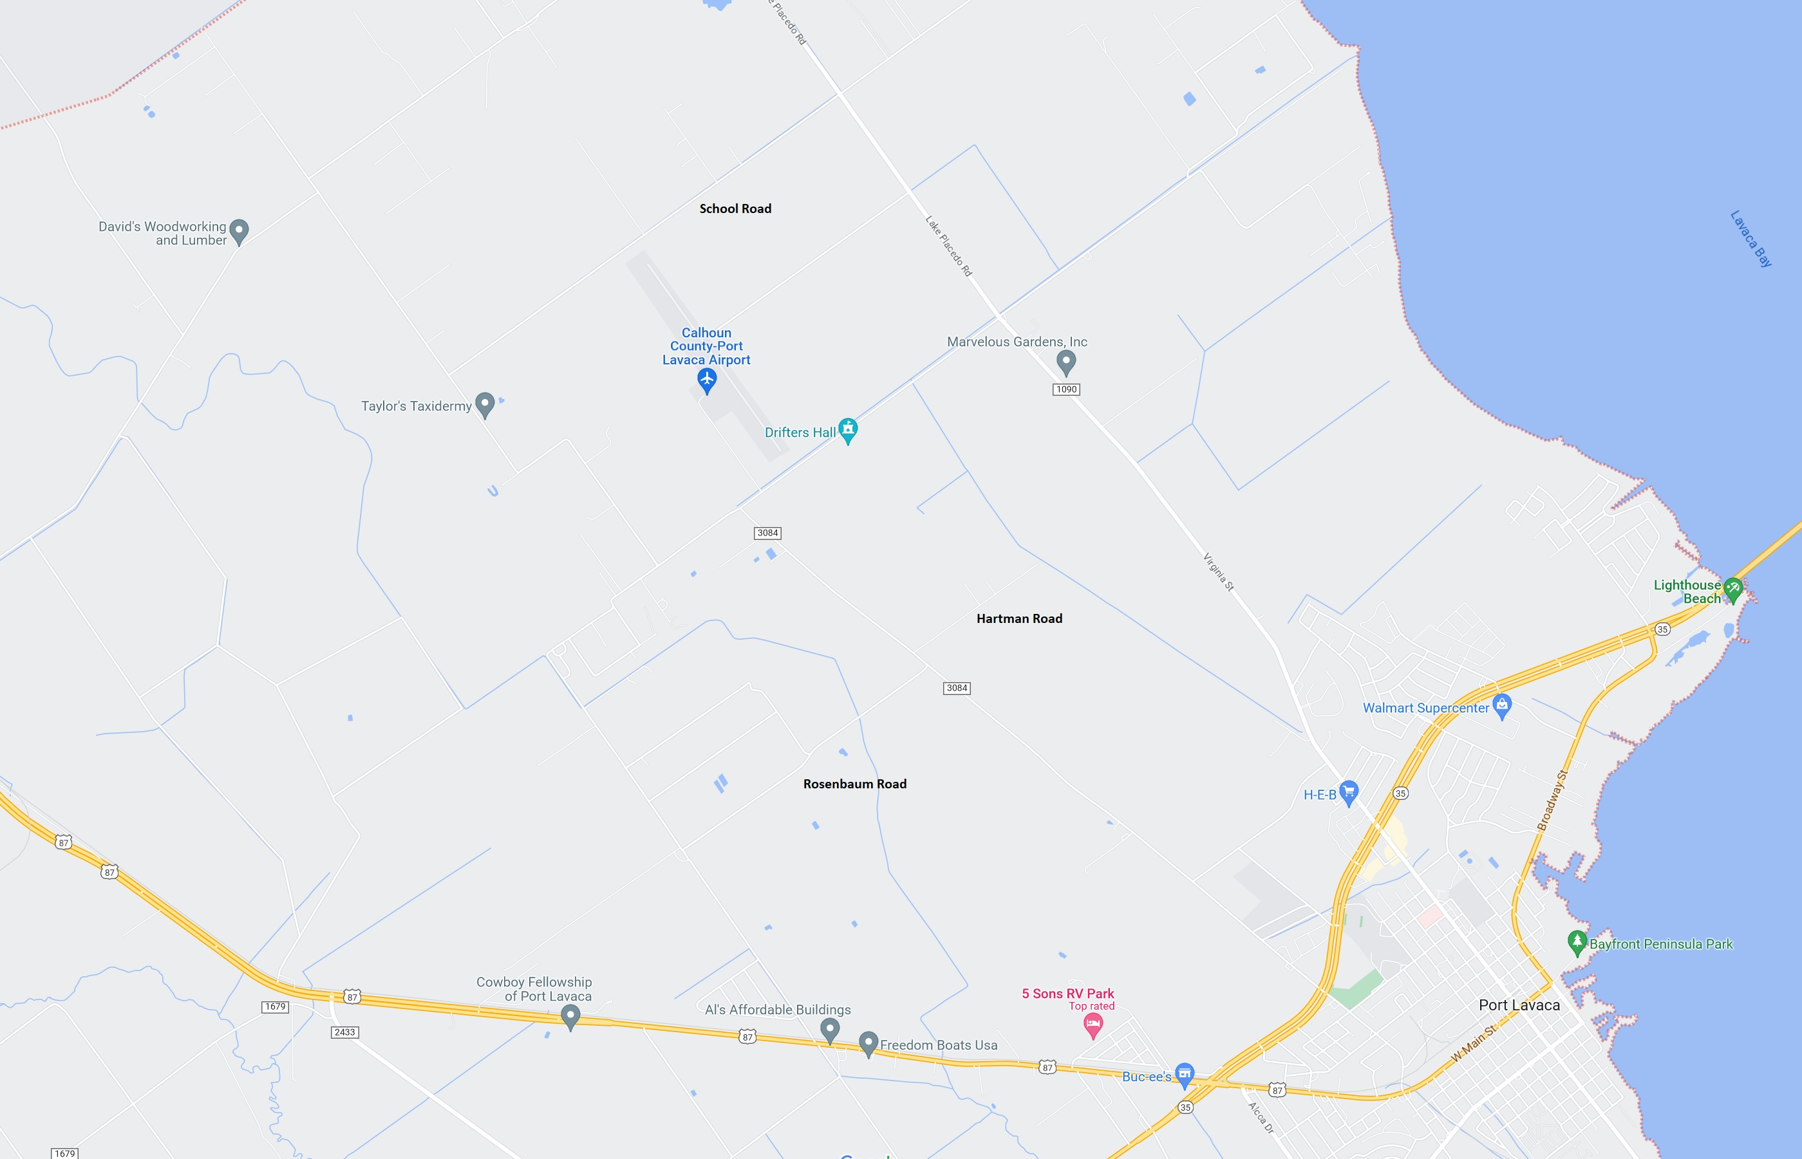

Terra Fog 4 MILES OF ROAD
COUNTY OF CALHOUN PORT LAVACA, TX
https://youtu.be/r-dWIBK5zAw?si=kgcLJxQPBYHRSg9R

Slide 24
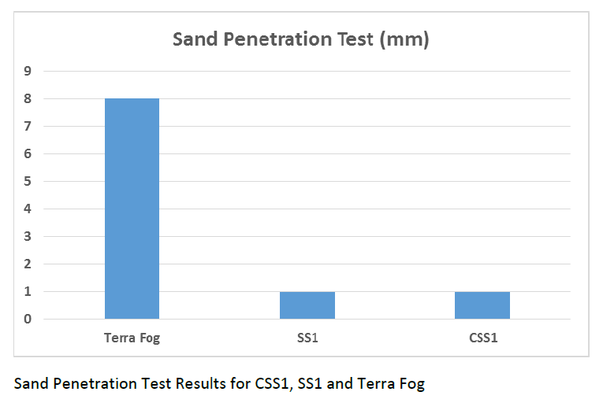
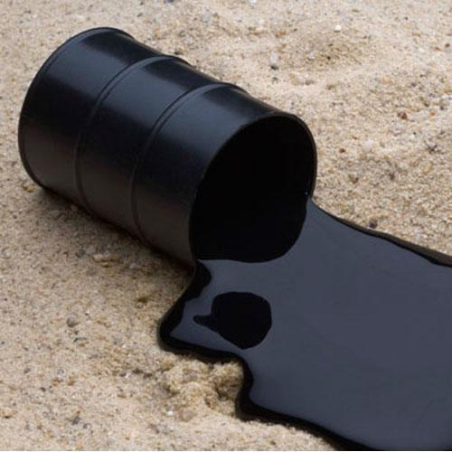
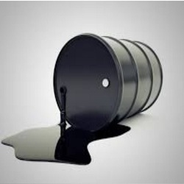
Pavement Preservation
Higher is BEST
Asphalt Emulsion Product - SS1 Bitumen Emulsions
Asphalt Emulsions
Asphalt Emulsion Product - Cationic CSS-1 Asphalt Emulsions

Slide 25
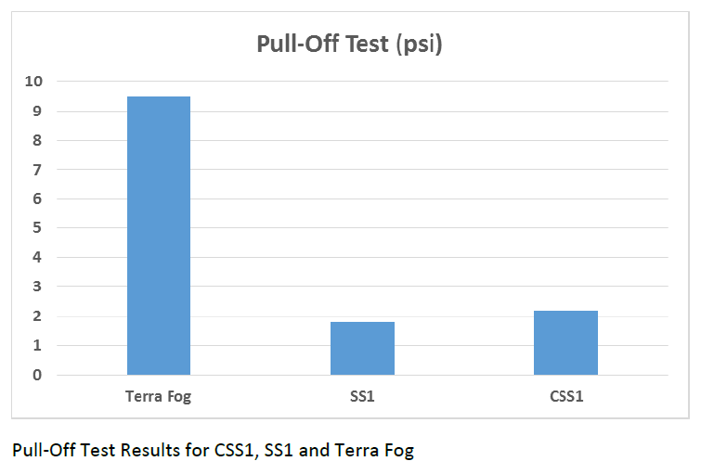
Pavement Preservation
Higher is BEST
Asphalt Emulsion Product - Cationic CSS-1 Asphalt Emulsions
Asphalt Emulsion Product - SS1 Bitumen Emulsions
Asphalt Emulsions

Slide 26
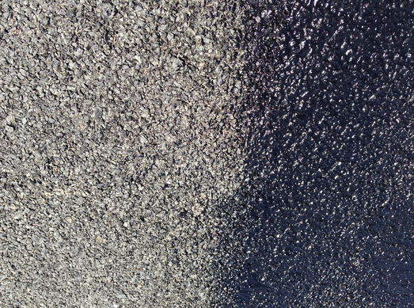
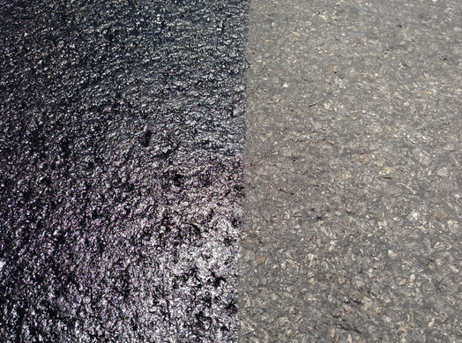
Terra Fog City of Austin, TX USA Test Section
Fresh Terra Fog atop
Chip Seal
Fresh Terra Fog atop
old, oxidized asphalt

Slide 27

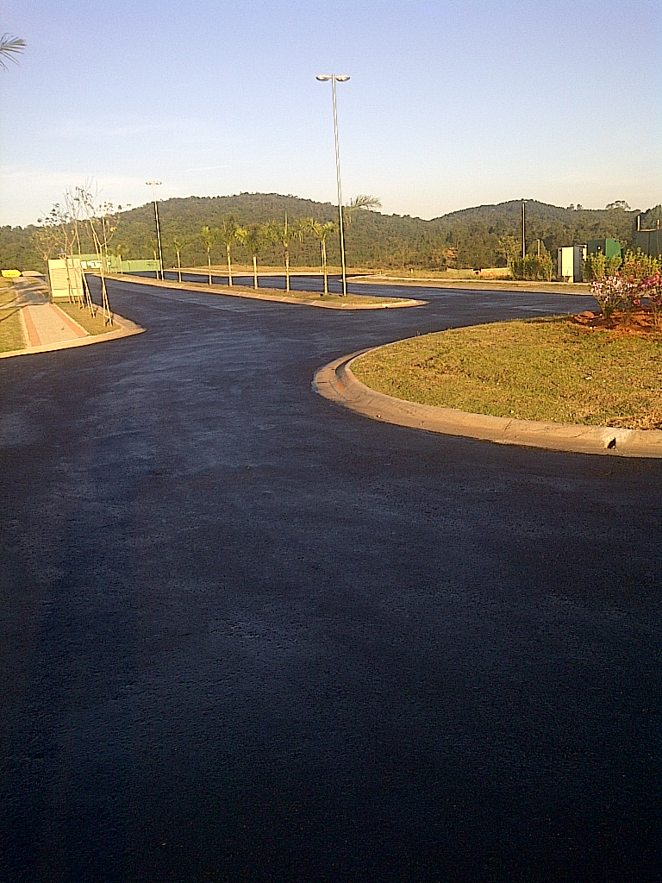
Terra Fog – RIO D, Brazil Road Repair
Environmentally Safe
Superior Strength
Cost-effective
Impermeable
Rapid Curing
Notes:
No Changes

Slide 28

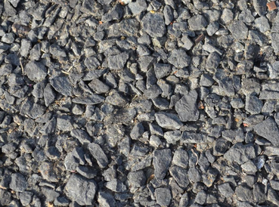
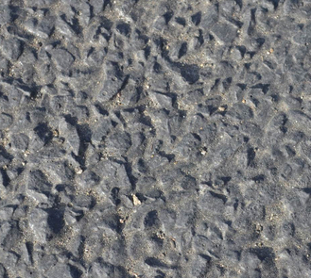
Terra Fog - City of Austin, TX USA Test Section
Chip Seal vs. Chip Seal with Terra Fog overlay
BEFORE
AFTER

Slide 29
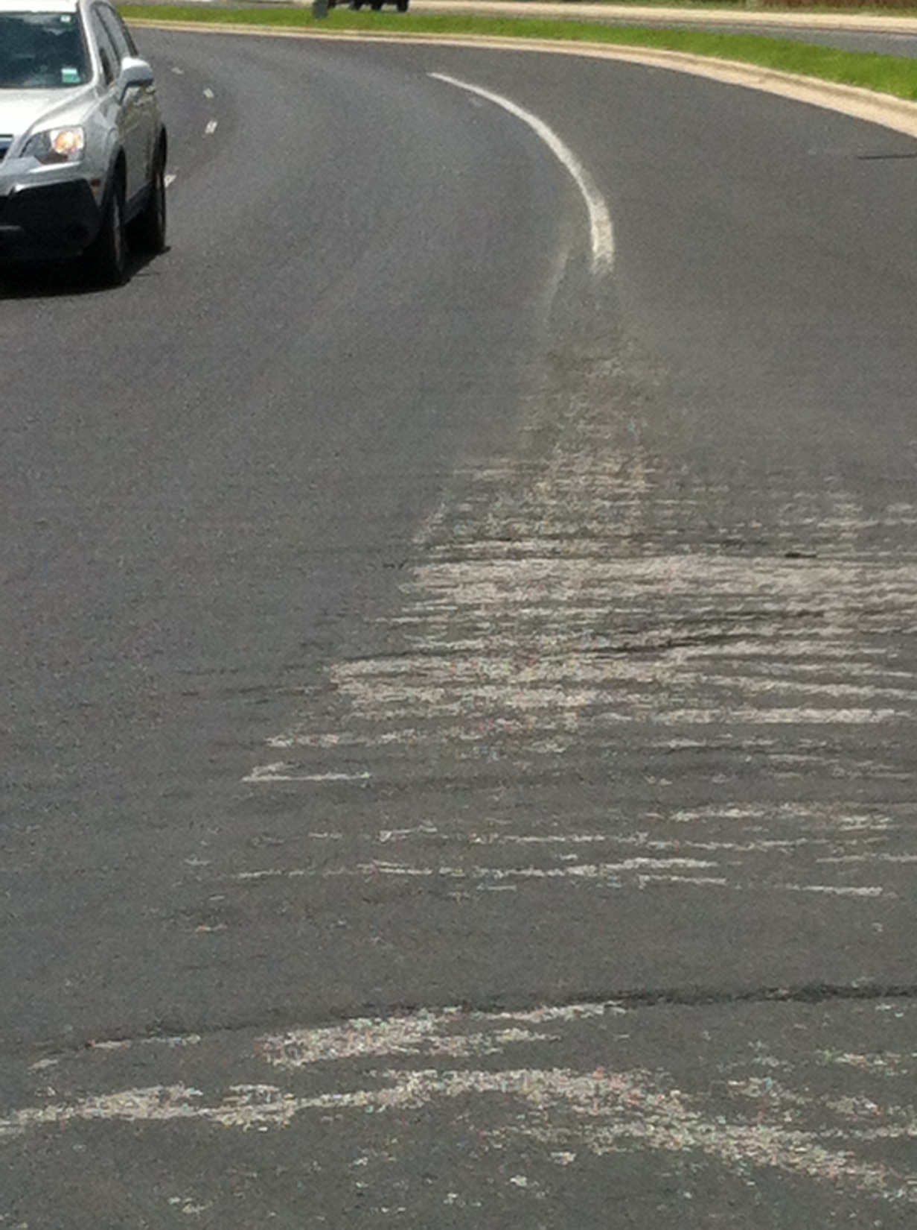
Terra Fog - City of Austin, TX USA Test Section
Chip seal section with Terra Fog did not loose any aggregate
whereas
Section without Terra Fog lost significant amount of aggregate less than one year after construction
Section with Terra Fog
Section without Terra Fog

Slide 30
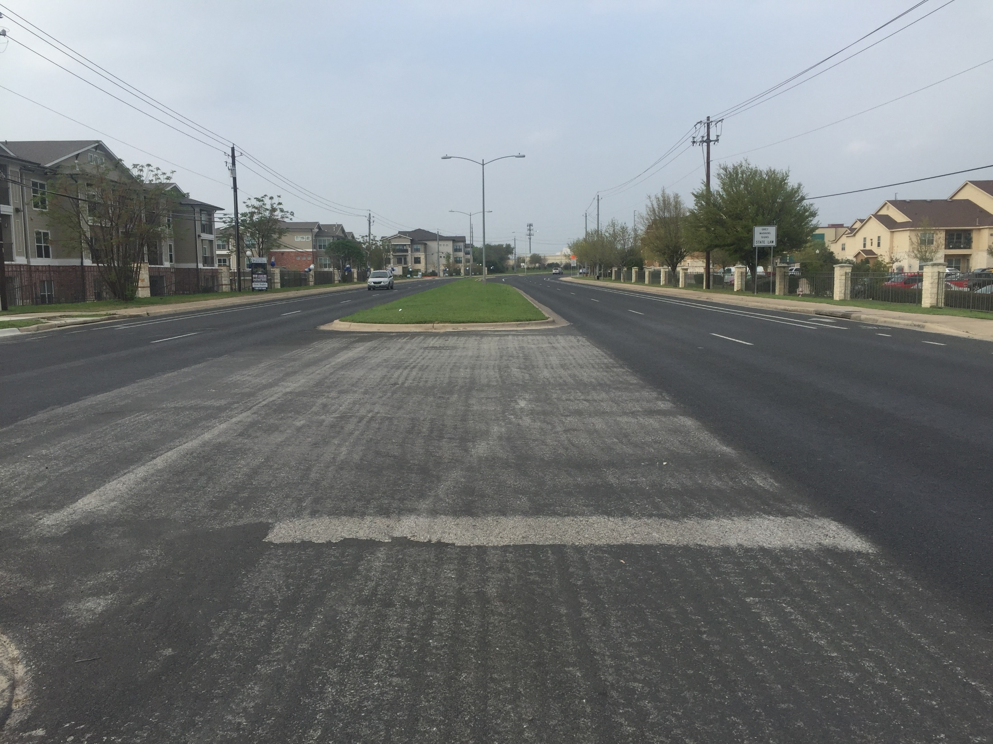
Terra Fog - City of Austin, TX USA Test Section
Section with Terra Fog
Section with Terra Fog
Section without Terra Fog

Slide 31
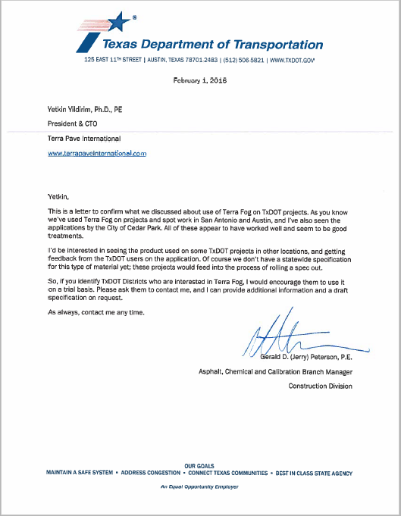

RECOMMENDATION FROM
TXDOT (TEXAS DEPARTMENT
OF TRANSPORATION)

Slide 32

TOP-SEAL
TOP-SEAL
TM
TOP-SEAL ALBEDO COOL PAVEMENTS (TSACP) Road
Liquid Soil Sealant & Stabilizer
Reduce Road Temperature
PROMOTED and SOLD in MORE THAN 30 COUNTRIES

Slide 33
TERRA SEAL ALBEDO COOL PAVEMENTS ADVANTAGES
The USA EPA defines HEAT ISLANDS: Heat islands are urbanized areas that experience higher temperatures than outlying areas. Structures such as buildings, roads, and other infrastructure absorb and re-emit the sun's heat more than natural landscapes such as forests and water bodies.
A program employing a network-level, long-term strategy that lower the temp. of, the road by at least -18 degrees F and a cost-effective set of practices that:
  extend pavement life and lower road temperature
  improve safety, and
  meet motorist expectations (enjoyable ride)
  no car damages due to distressed, very hot roads.

Slide 34
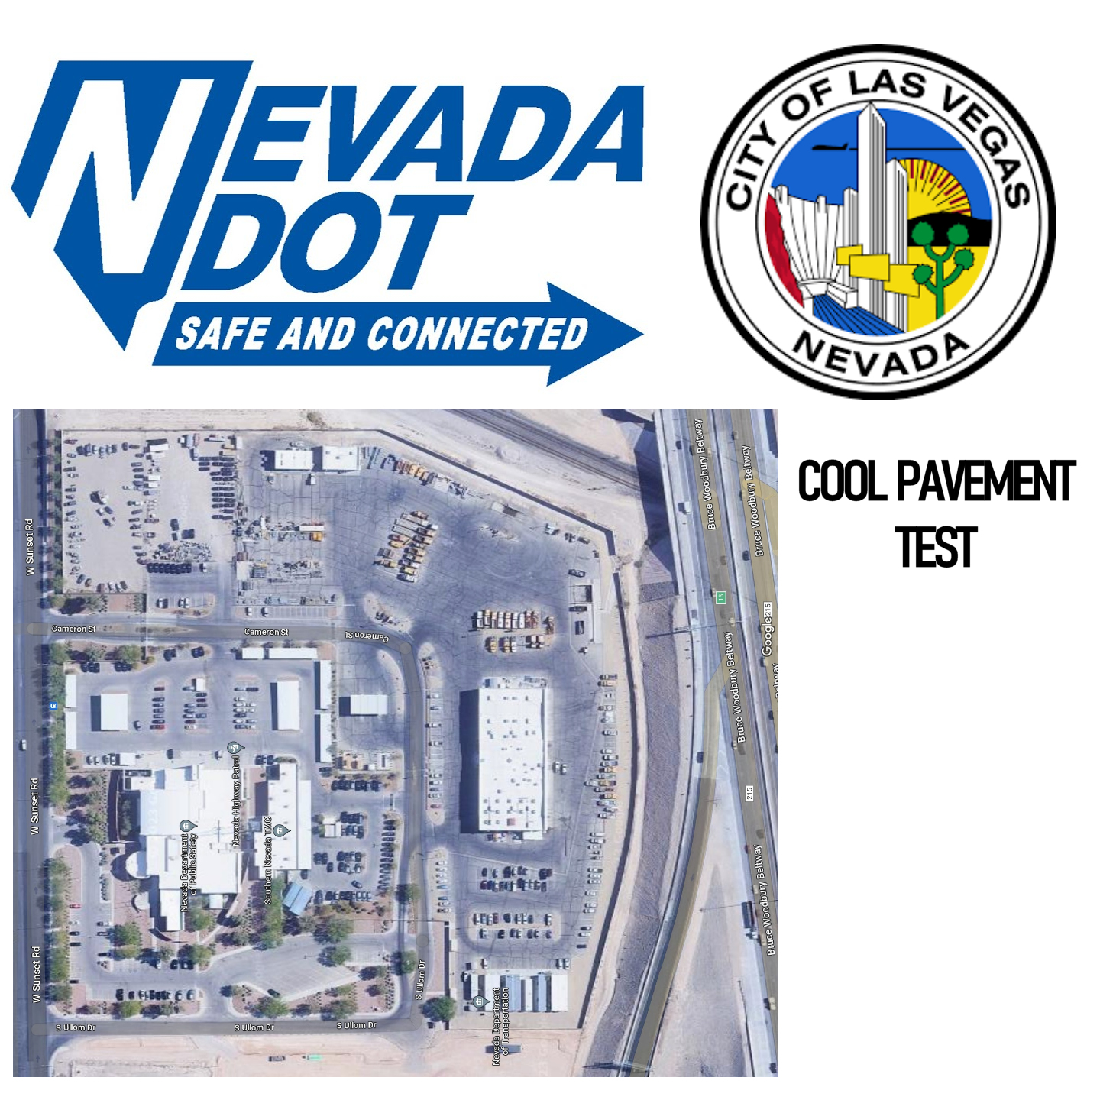
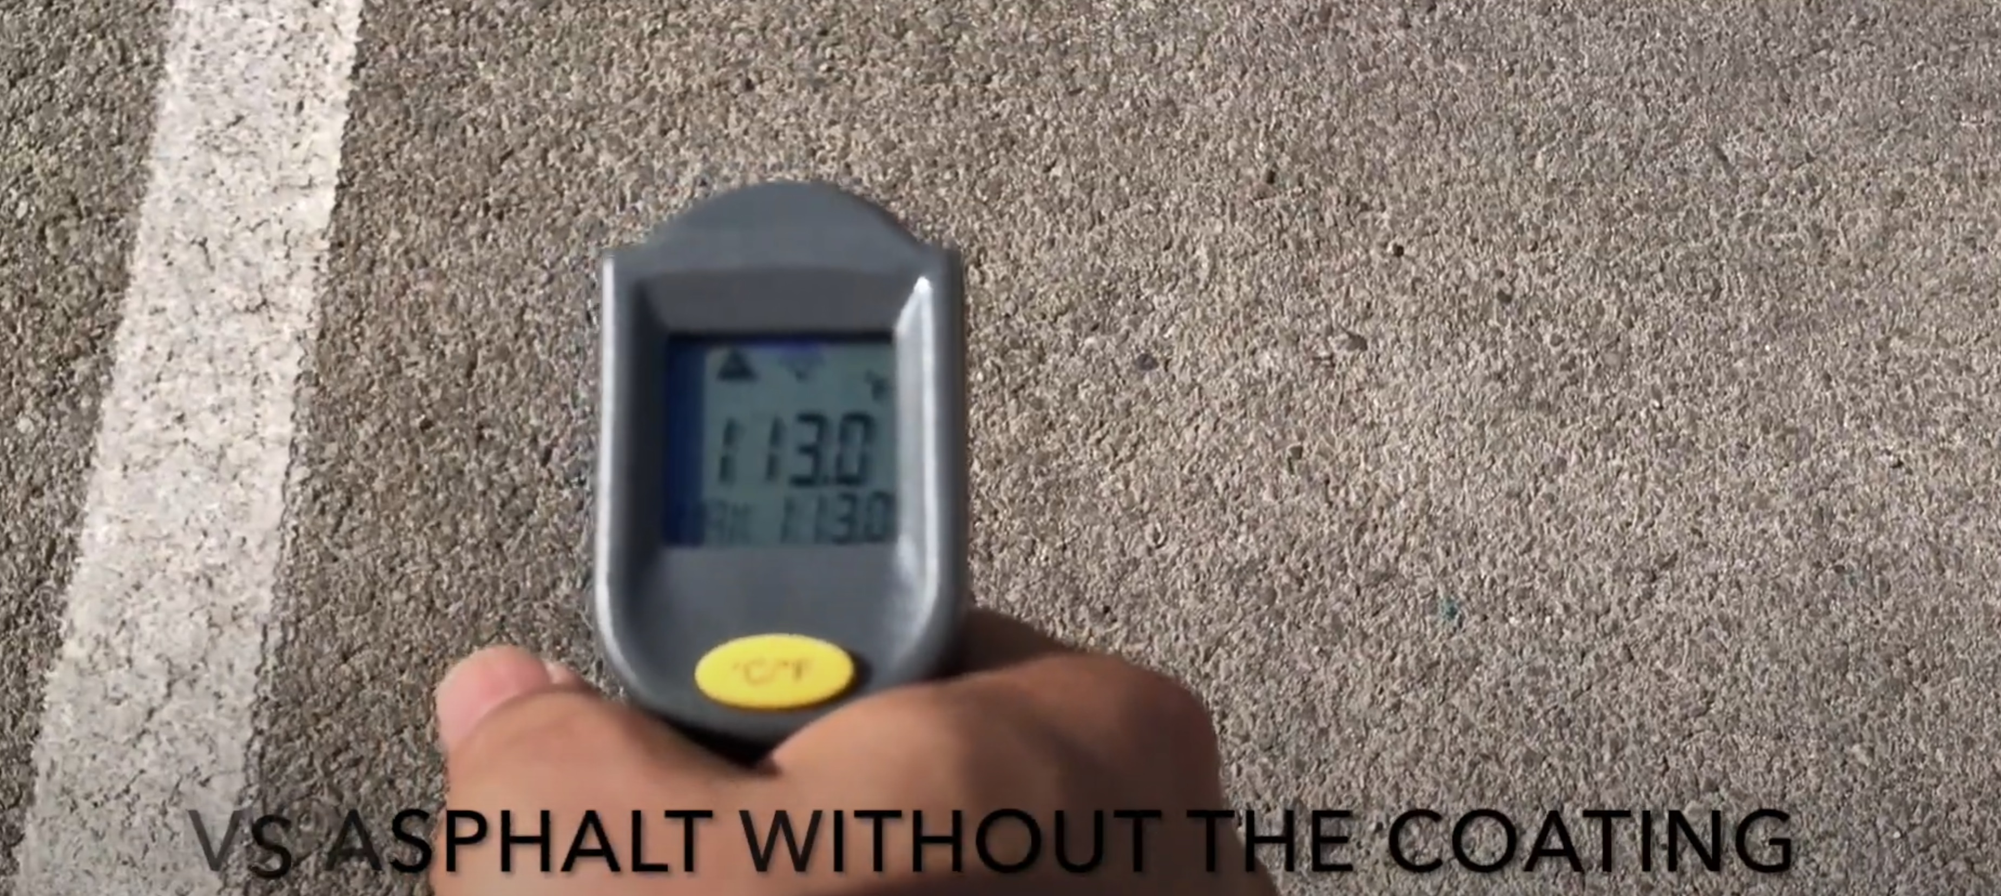
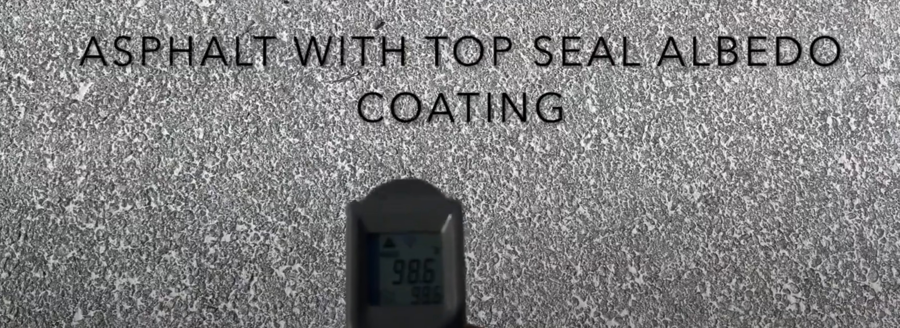
TOP-SEAL ALBEDO
Cool pavements (TSAcp)
TSACP lowered the road temperature
by -18 degree F for the Nevada Department of Transportation (NDoT)

Slide 35
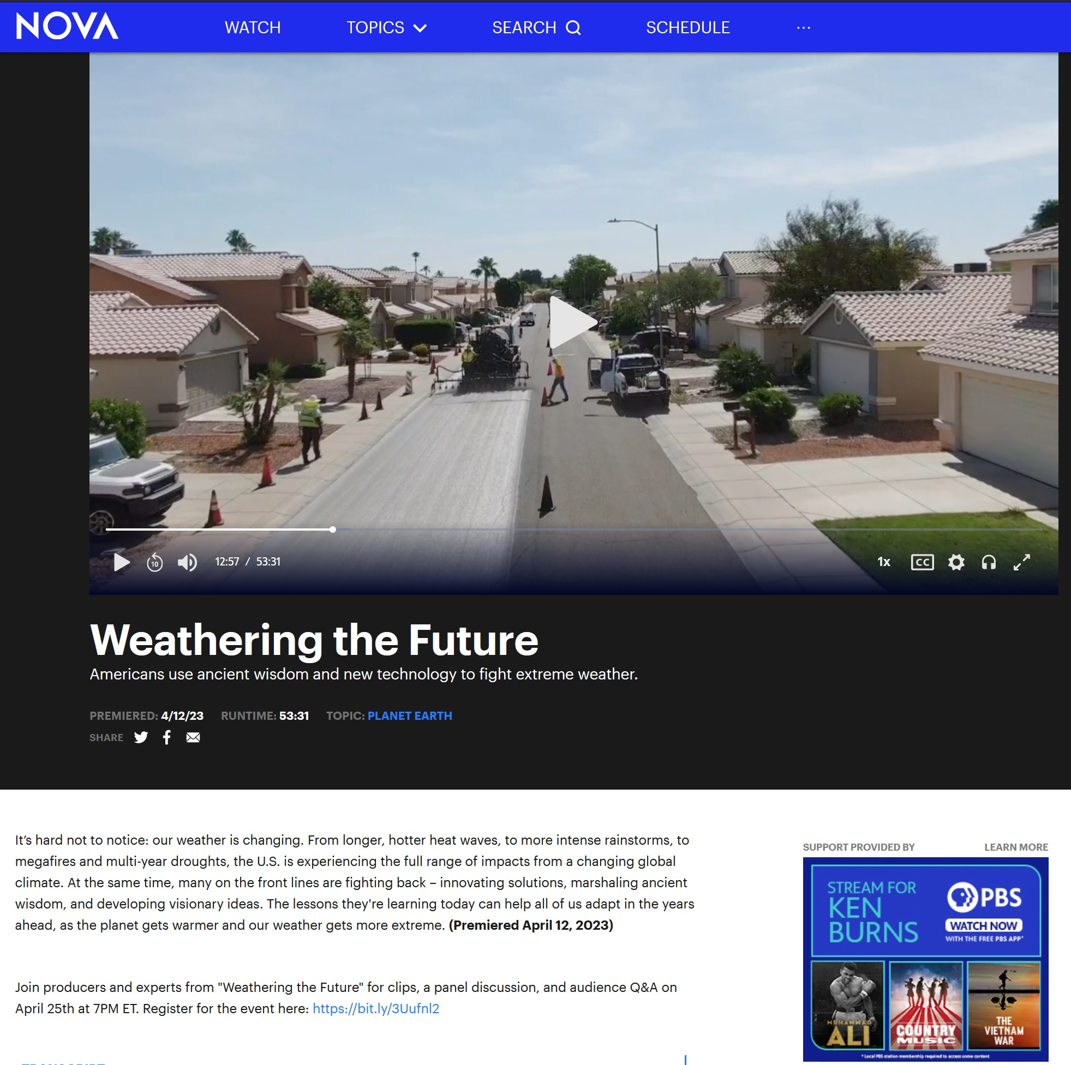

Reduce Heat-absorption
TSACP improves highway/road quality and durability by reducing the heat-absorption from the sun. City of Phoenix, AZ 36 miles of roads to reduce the heat. NOVA PBS – Weathering the FUTURE
It has advantages such as:
Water-based
Cold-applied
Faster Curing
Greater Strength
Non-flammable
Non-toxic
No VOCs (Volatile Organic Compounds)
Reduces the heat absorption from the sun
https://www.pbs.org/wgbh/nova/video/weathering-the-future/
Premiered: April 23, 2023

Slide 36
TOP-SEAL
TOP-SEAL
TM
TPWhite & TPBlack & TPrime
Replacement for Asphalt / Concrete Roads
Building NEW Roads & Pavements

Slide 37
TOP-SEAL
TOP-SEAL
TM
TOP-SEAL White (TSW)
Liquid Soil Sealant & Stabilizer
Concrete Replacement
PROMOTED and SOLD in MORE THAN 30 COUNTRIES

Slide 38
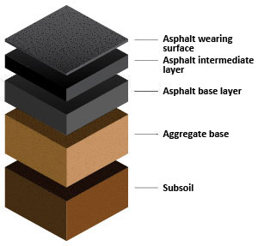




Terra pave white (base, UNPAVED ROADS)
ASPHALT ROAD CROSS SECTION
TERRA PAVE WHITE
(Base, Concrete Replacement, Unpaved Roads, Airfield, etc..)

Slide 39
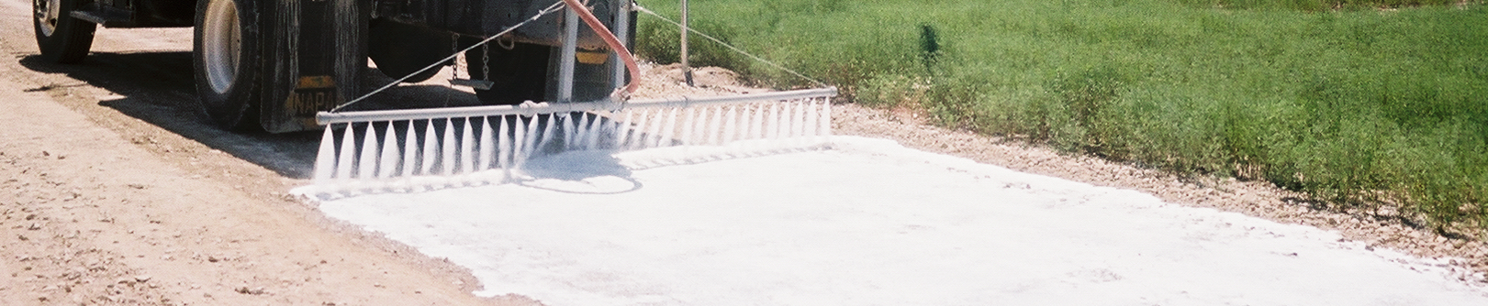
TOP-SEAL White (TSW)
TSW is a water-based polymer soil additive that powerfully binds EXISTING soil particles into a hardened and moisture-resistant mass or Eco-Friendly Waterproof Concrete Replacement.
TSW will (1) stabilize and waterproof road bases,
(2) prevent soil erosion
(3) pavement for dirt and, un-improved roads

Slide 40
TOP-SEAL White
CONSTRUCTION & RECONSTRUCTION
Paved and Unpaved Road Bases
Airfields, Runways, Helicopter Landing Pads
Landfills
Embankments
Foundations For Homes & Commercial Buildings
Driveways, Parking lots
Slope Erosion Control
Water Retention Basins & Pond Linings
Cart Paths, Golf Courses
Base Stabilization
Military Convoy & Tank Trails and many more applications
Solar Energy Farms/Albedo Bifacial Solar Field – TSW Solar Albedo

Slide 41
HOW DOES TOP-SEAL WORK?
After being evenly and thoroughly distributed into the soil, and with good compaction, Top-Seal will begin the process of irreversibly transforming from a liquid to a solid.
The product continues to interact with the soil as a hardening agent that dramatically increases soil strength and resistance to moisture.
* Soil Grader
                * Water Sprayer
        * Soil Compactor

Slide 42
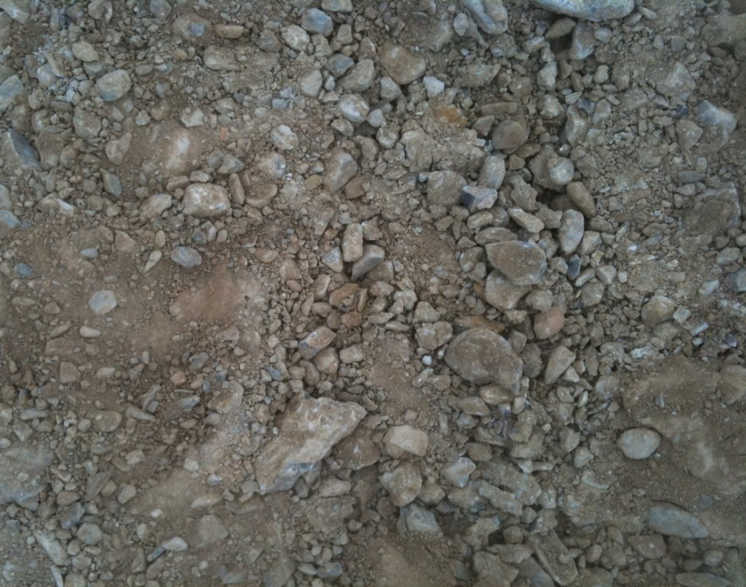
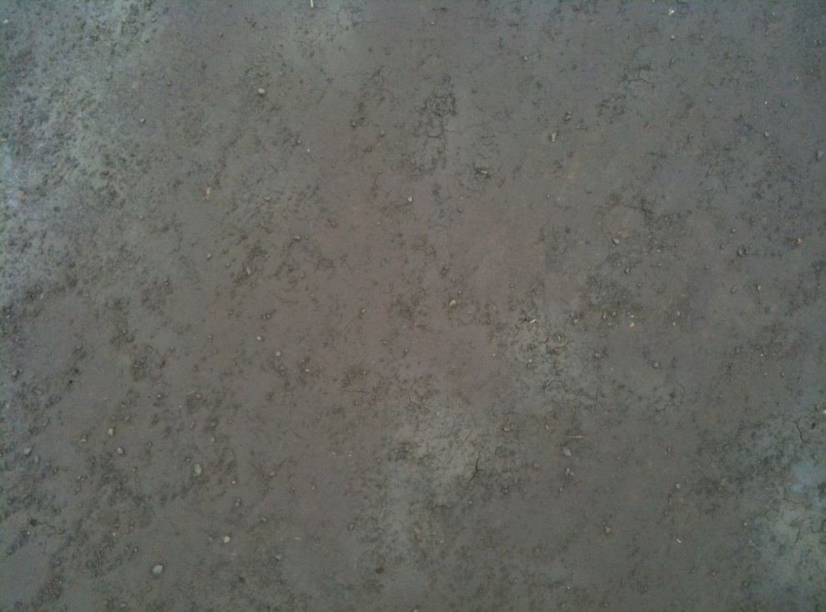

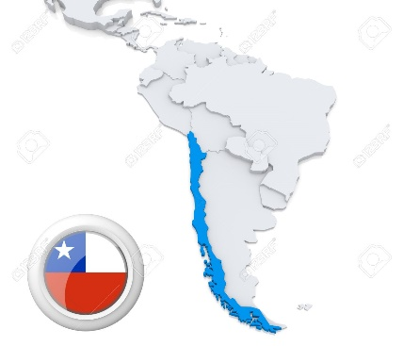
BASE STABILIZATION
A CLOSER LOOK
BEFORE & AFTER TSWTM in CHILE, SOUTH AMERICA
BEFORE AFTER
https://youtu.be/RkMJOQr2rus

Slide 43
EXTREMELY CHALLENGING
Top-Seal was “BATTLE TESTED” with a daily exposure to the extremes of severe weather conditions and constant convoys of M1-Abram tanks and other heavy armored vehicles at a military installation in Central Texas USA.
The following slides will show how well Top-Seal can be expected to perform in extremely challenging environments.

Slide 44
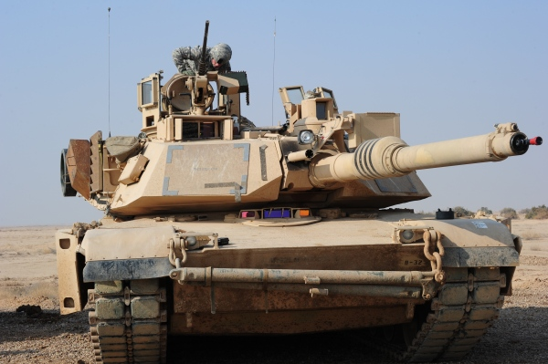
IMPROVEMENT of a
MILITARY ROAD

Slide 45
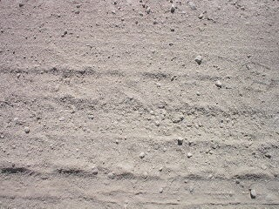
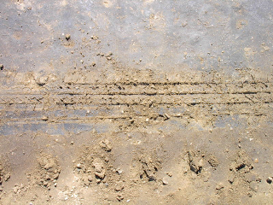
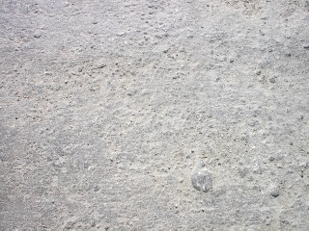
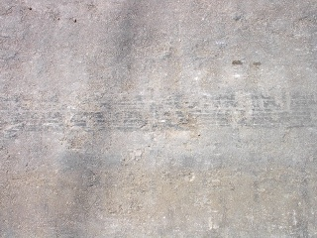
COMPARISON SIDE-BY-SIDE
UNTREATED SOIL
COMPETITOR PRODUCT
Road surface is damaged by skid marks
SIX WEEKS AFTER TREATMENT WITH TOP-SEAL WHITE
TOP-SEAL WHITE
No surface damage Only black tire marks are visible from skid marks

Slide 46




ANOTHER COMPARISON
COMPETITOR PRODUCT
COMPETITOR PRODUCT
TOP-SEAL WHITE
TOP-SEAL WHITE

Slide 47



TOP SEAL White – EXXON-MOBIL Project
Terra Pave White - Corpus Christi, TX – Exxon Mobil road project completed with Terra Pave White - Ultra-heavy Module for the Exxon GCGV project near Corpus Christi, Texas crossed the finish line.
This was 4.5 miles of heavy haul road (HHR) supporting up to 140psi SPMT wheel loads transporting up to 12,000 Metric Tonne modules. There were over 100 transport runs with over 30 ultra-heavy modules. The design was for 10,000 cumulative axle passes over any one point.
https://vimeo.com/377598222

Slide 48


(California Bearing Rate)

Slide 49
Cement Modulus base stabilization
Cement Modulus base stabilization
Cement Modulus base stabilization
1 MPa = 145 PSI
(Megapascal)

Slide 50
1 MPa = 145 PSI
(Megapascal)

Slide 51

BEST

Slide 52

More
Permeable
USEPA STANDARD
1x10-7 cm/sec
1.0E-07
Permeability Coefficient
2.9E-09
The USEPA standard of 1x10-7 cm/sec. it would take liquid 4.76 years to traverse 15 cm.
Soil Type: Sandy Loam
Top-Seal treated soil, at 2.9x10-9 cm/sec. the liquid would need 16.4 years to go through 15 cm.
Less
Permeable

Slide 53
TERRA PAVE WHITE

Slide 54
BASE STABILIZATION
Ø Vastly superior road base stability.
Ø A tremendous increase in strength and a significant reduction of permeability.
Ø Life expectancy of paved and unpaved roads will be significantly extended. 2x-4x times
TOP-SEAL WHITE

Slide 55
TOP-SEALTM
TOP-SEAL WHITE and
TOP-SEAL BLACK
ASPHALT ROAD REPLACEMENT
Terra Pave International, Inc.

Slide 56
Terra pave white & Black
(base, concrete, asphalt replacement)
ASPHALT ROAD CROSS SECTION
TERRA PAVE BLACK
(Asphalt Replacement)
NO MC-30/AEP is needed
TERRA PAVE WHITE
(Base Replacement)

Slide 57






Terra pave white & Black
(base, concrete, asphalt replacement)
TERRA PAVE PRODUCTS – TPW & TPB Concrete/Cement/Asphalt Replacement
BEFORE
AFTER
AFTER
TPW after 24 hours of curing
TPB after 48 hours
https://youtu.be/hhcGYhf1HPs
Loose soil
NON-HAZADOUS
NON-PETROLEUM BASED
NON-TOXIC
NON-CORROSIVE
WATERPROOF
IMPROVES BRAKING DISTANCE
EROSION RESISTANCE
NO SPECIAL HANDLING PROCEDURE
NO SPECIAL EQUIPMENT NEEDED
* Soil Grader * Soil Compactor * Water Sprayer

Slide 58

Loose soil prepared for application of TSW
Notes:
Loose soil prepared for application of TSW

Slide 59

Application of Top-Seal White
Notes:
Application of Top-Seal White

Slide 60

Top-Seal White soaking into the soil into the base
Notes:
Top-Seal White soaking into the soil in the 2nd section

Slide 61

Top-Seal White after 24 hours of curing – close up
Notes:
Top-Seal White after 24 hours of curing – close up

Slide 62


First application of Top-Seal Black
Notes:
First application of Top-Seal Black

Slide 63

Final application of Top-Seal Black
Notes:
Final application of Top-Seal Black completed

Slide 64

Top-Seal Black – close up after 48 hours
Copyright © 2011 Terra Pave International, Inc. All rights reserved
Notes:
Top-Seal Black – close up after 48 hours

Slide 65

Top-Seal Black – one month later
Notes:
Top-Seal Black – one month later

Slide 66

Top-Seal Black – Two Years later

Slide 67
TOP-SEAL
TOP-SEAL
TM
TOP-SEAL TERRA PRIME
Replacement for TOXIC MC-30, AEP
Pavement Quality & Durability
PROMOTED and SOLD in MORE THAN 30 COUNTRIES,

Slide 68

Terra Prime (prime coat)
Terra Prime improves highway quality and durability by waterproofing, plug capillary voids, coat and bond loose mineral particles in the sub-base layer of asphalt pavements. Terra Prime penetrates, bonds and stabilizes the sub-base layer of asphalt pavements, thereby waterproofing it before placing the hot mix asphalt. Reducing the heat-absorption from the sun.
As a replacement for Toxic/Cancer-Causing Kerosene of MC-30, AEP, it has advantages such as:
Water-based
Cold-applied
Faster Curing
Greater Strength
Non-flammable
Non-toxic
No VOCs (Volatile Organic Compounds)
Reduce the heat-absorption from the sun
https://youtu.be/_i-Z5qdsl90

Slide 69
Terra Prime (prime coat)
ASPHALT ROAD CROSS SECTION
TERRA PRIME
(Toxic MC30, AEP Replacement)
waterproofing,
plug capillary voids
coat and bond loose mineral particles
MC30/AEP Tack Coat layers

Slide 70


TERRA PAVE PRODUCTS - Recommendation
City of San Marcos, TX Environmental Engineer
Lisa Arceneauz, P.E., CISEC, CPESC
Environmental Engineer
City of San Marcos, Texas
Notes:
Recommendation from City of San Marcos, TX DOT: “clearly shows the advantage of this product for human health and the environment. Street manager is considering required all city’s asphalt contractors to use Terra Pave. This proactive step will have a significant multiplying benefit for the environment. “ IMAGINE FOR ALL CITIES ON THE PLANET! YES WE CAN!

Slide 71


PACKAGING
TP products are packaged in 55 gallon (208 liter) drums or in 275 gallon (1,040 liter) totes. In the interest of convenience, it is highly recommended that TP products be delivered in 275 gallon totes. The totes require less handling and each tote is equipped with an on/off valve near the bottom for easy transfer of the product into a water truck.

Slide 72



ECOLOGICAL ESTATES LLC. / EEI Holding
P.O.Box 171214
Austin, Texas USA
UTA-TERRA PAVE INTERNATIONAL, Inc.
West Pickle Research Center
The University of Texas at Austin
Austin, Texas USA
Email: info@terrapavetech.com
Web: www.terrapavetech.com

Slide 73


HRTS
TOP-SEAL
TM
HAUL ROAD TOP-SEAL
Commercial Grade
Dust Pollution Control
PROMOTED and SOLD in MORE THAN 30 COUNTRIES

Slide 74



TOPICAL APPLICATIONS
Primarily Used for Dust Control
and General Road Improvement
This type of application is the most common use for HRTS. It is cost-effective and easy to apply. All known environmental standards can be met or exceeded by using HRTS for eliminating dust pollution. Especially in mining operations where the dirt is toxic and cancer causing.

Slide 75


HAUL ROAD TOP-SEAL (HRTS)
HRTS is an excellent choice for stabilizing haul roads and controlling extremely heavy amounts of dust pollution.
Military Roads, Parking Lots, Quarries, Mines, Logging Roads
The HRTS program has been successfully used on haul roads with daily traffic extremes of hundreds of fully loaded trucks of 50 or more tons.

Slide 76

350 ton Trucks

Slide 77

INTERNATIONALLY RECOGNIZED
Featured on the cover of Aggregates Manager magazine, Terra Pave’s former version of Haul Road Top-Seal (HRTS™) was internationally recognized for its excellent performance in controlling dust pollution at a large quarry in North Texas USA.
ONE YEAR AFTER INITIAL APPLICATION NO DUST

Slide 78

BASE STABILIZATION
COMPLETED PROJECT

Slide 79
BASE STABILIZATION
CONSTRUCTION of NEW ROADS or RECONSTRUCTION of EXISTING ROADS
This type of application requires the product to be mixed with water and distributed into the soil prior to each round of compaction.
This method is used primarily for rebuilding an unpaved road or for base stabilization of a paved road.

